Slide 1

Presentation
On
“Attendance Management System ”
Submitted to:-
Trainer: Mr. Pawan Sahu
Presented By :-
Shivam Ahirwar

Slide 2

Notes:
2

Slide 3

Introduction to AMS
The Attendance Management System (AMS) is a desktop application designed to replace manual attendance registers. It offers a secure, efficient, and user-friendly solution for managing student attendance.
Teachers can manage student data and record attendance, while students can easily view their own records. Built with Java (NetBeans IDE) and a MySQL backend, AMS streamlines the entire process.
Notes:
3

Slide 4




Key Project Objectives
Automate Process
Reduce manual paperwork and streamline attendance recording.
Accurate Data
Provide real-time, precise attendance information.
Enhance Security
Implement role-based logins for Teachers and Students.
Generate Reports
Create an attendance report by batch.
Notes:
4

Slide 5
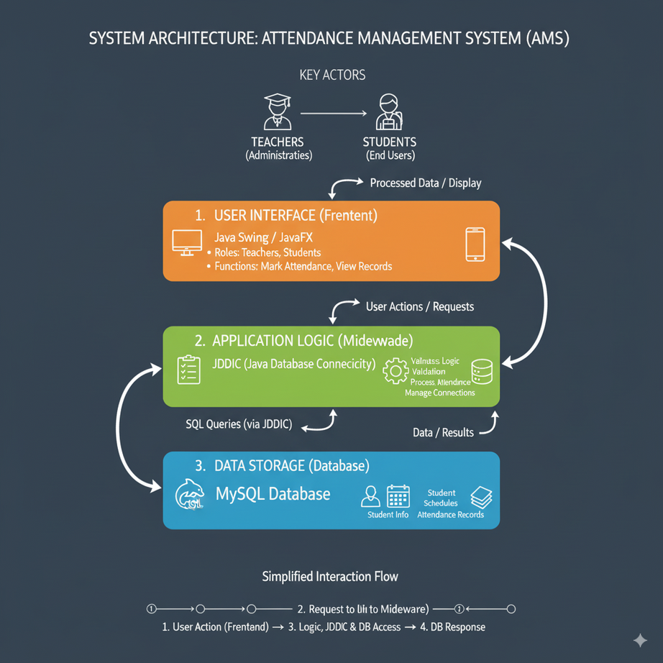
System Architecture Overview
The AMS is structured with distinct layers to ensure robust functionality and data management.
Frontend: Java Swing/JavaFX for the user interface.
Backend: MySQL database for storing all records.
Middleware: JDBC facilitates seamless database connectivity.
Key actors interacting with the system include Teachers (Administrators) and Students (End Users).
Notes:
5

Slide 6





Core System Modules /Features
Authentication
Secure login/logout for Teachers and Students with credential validation.
Student Management
Add, update, and delete student records including personal details.
Attendance
Mark daily attendance (Present/Absent) and modify past entries.
Batch Management
Group students into batches and track attendance batch wish.
Reporting
Generate attendance sheets and allow Teacher to view summaries.
Notes:
6

Slide 7
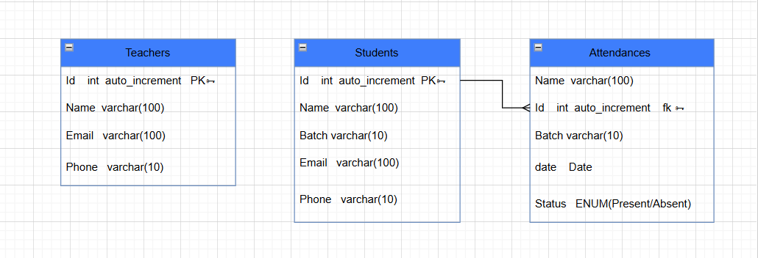
Database Design
The AMS database is structured with three main tables to store all necessary information:
Notes:
8

Slide 8
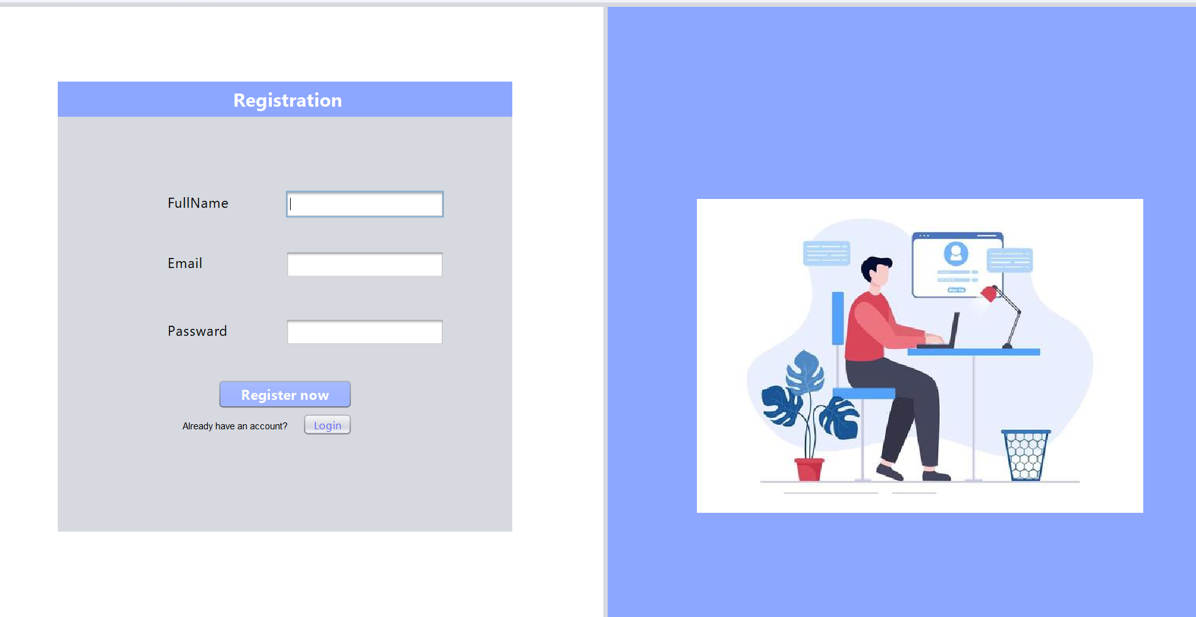
Registration Page

Slide 9
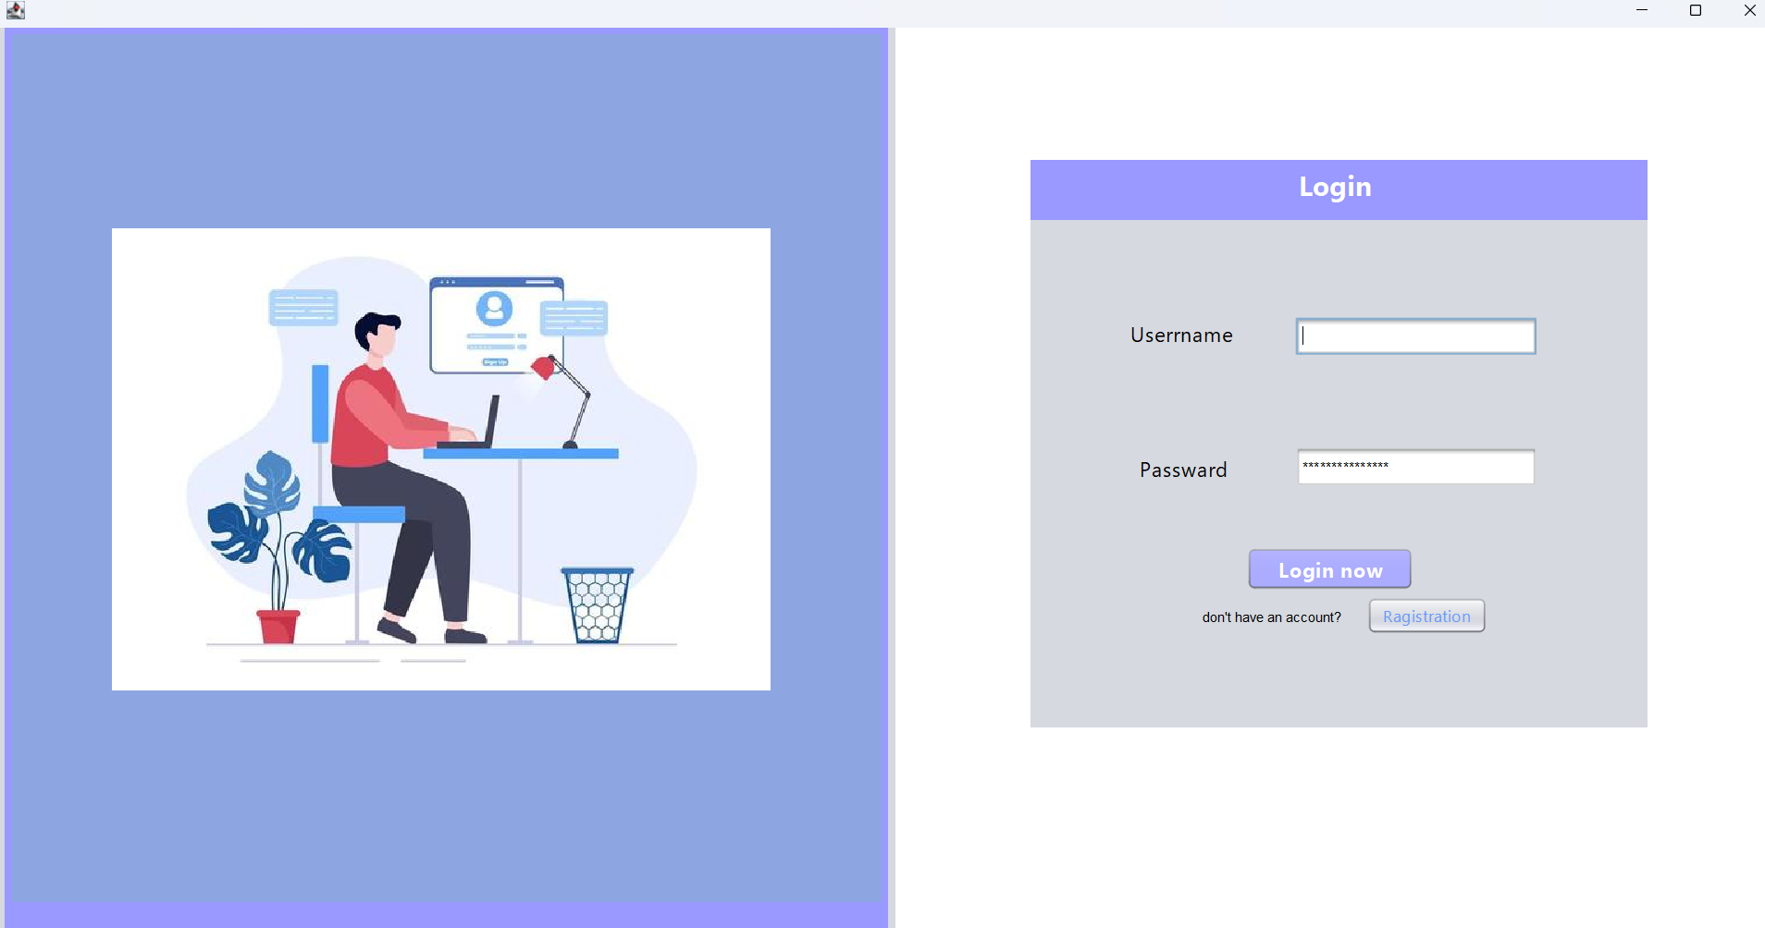
Login Page

Slide 10
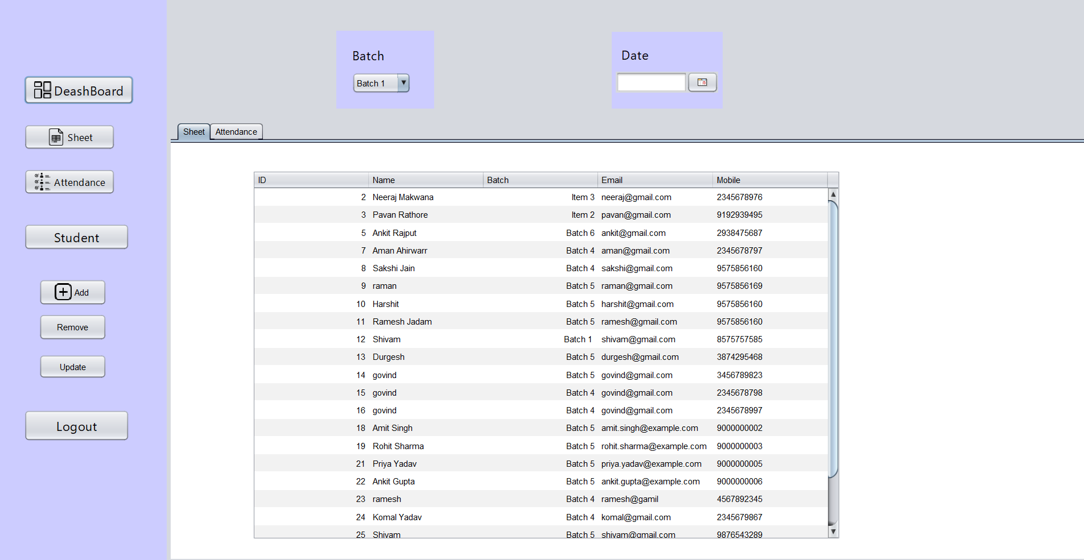
Dashboard Page

Slide 11
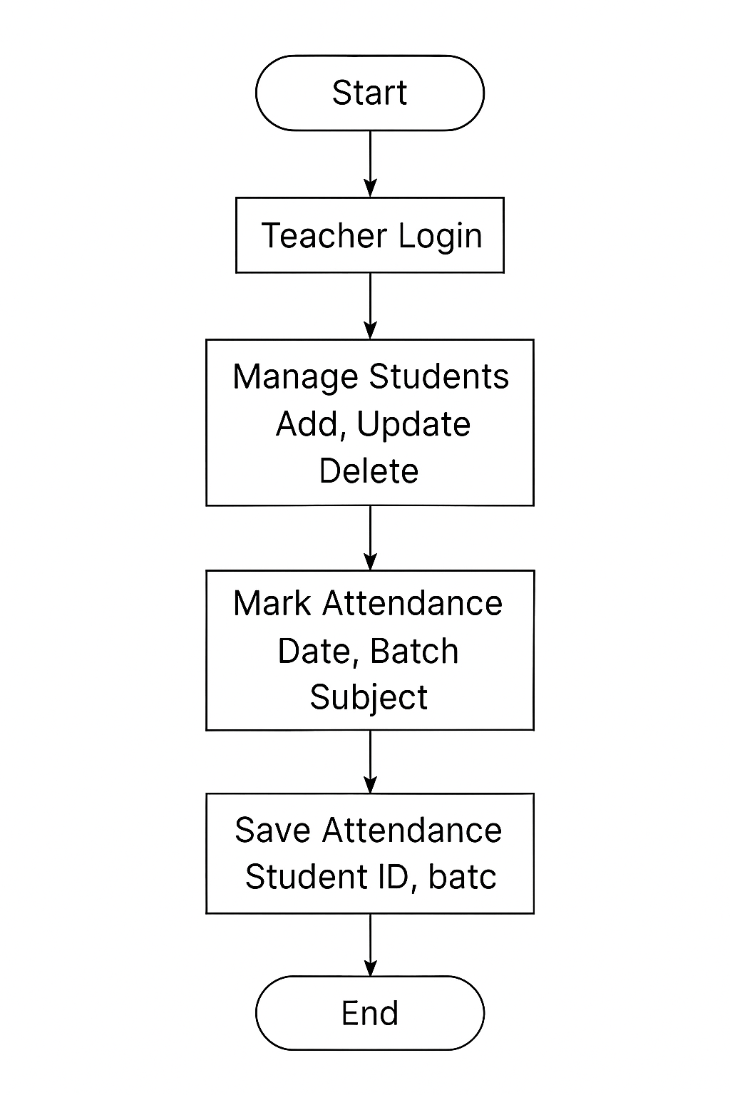
Working Structure
The system starts with the teacher login page.
Teacher enters valid credentials to access the dashboard.
From the dashboard, the teacher manages student records — add, update, or delete.
Teacher selects the batch and for attendance.
The system displays students of the selected batch.
Teacher marks each student as present or absent.
Attendance details include date, batch, subject, and student ID.
The data is saved into the attendance table in the database.
Teacher can view or edit attendance records later.
Process ends after successful save or logout

Slide 12
Thank You

